Slide 1

ML FOR WIRELESS COMMUNICATION
UNSUPERVISED MACHINE LEARNING-BASED USER CLUSTERING IN THZ-NOMA SYSTEMS
TEAM:
ABHINAV DESHPANDE (IMT2022580)
AJITESH KUMAR SINGH (IMT2022580)

Slide 2


TABLE OF CONTENTS
Problem Statement
System Modelling and Beamforming
Problem definition
K-means
DBSCAN
AHC
Results obtained
Timeline Diagram

Slide 3

PROBLEM STATEMENT
6G Communication Need:
5G networks cannot meet future demands (ultra-high throughput, massive connectivity, ultra-low latency).
THz-NOMA as a Solution:
Terahertz (THz) spectrum offers ultra high bandwidth for communication.
Non-Orthogonal Multiple Access (NOMA) enhances spectral efficiency by allowing multiple users to share bandwidth.
Key Challenge:
Efficient user clustering in THz-NOMA networks without predefined cluster numbers.
Keep it or delete it!
Same

Slide 4
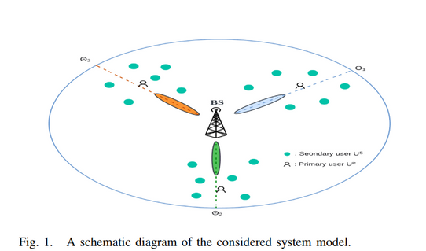

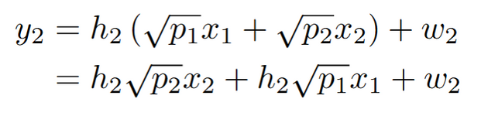



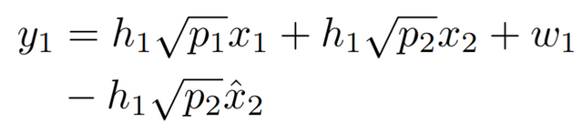

THz-NOMA System Model
NOMA: Non-orthogonal Multiple access. Transmit for entire time but assign different powers to users.
NOMA has 2 kind of users:
Primary User: Higher priority users with stronger channel.
Secondary User: Lower priority users with weaker channel
B.S.
h1 > h2
p1 < p2
Direct Decoding at S. User
h1
Term of interest
Treated as noise
P. User
SIC and then Decoding at P. User
h2
Successive Interference Cancellation (SIC)
S. User

Slide 5
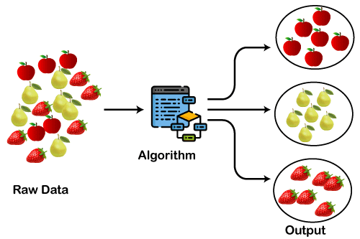
WHY CLUSTERING ?
Adaptive Resource Allocation
The THz spectrum is highly sensitive to attenuation and environmental factors. Clustering enables adaptive and automatic grouping of users based on spatial and signal characteristics.
The Base Station Starts Beamforming
BS : L antennas
Users : N
It cannot assign a dedicated beam to each user, so it has to group them into clusters.
Each cluster is assigned a beam, with one Primary User leading the group
Without Clustering : Some users end up in beams that don’t match their spatial positions, leading to signal distortion and packet loss.
Same

Slide 6
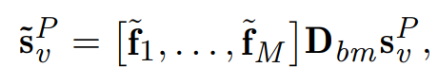
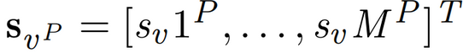
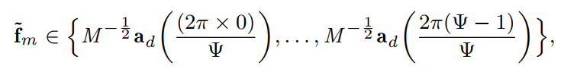
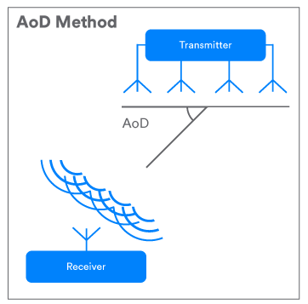
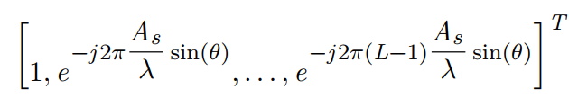
BEAMFORMING
Hybrid beamforming (analog and digital combined) for primary users.
Digital beamforming matrix
Signal vector sent from B.S.
to primary user
Analog Beamforming vector
Keep it or delete it!
Same
AOD (angle of departure)

Slide 7
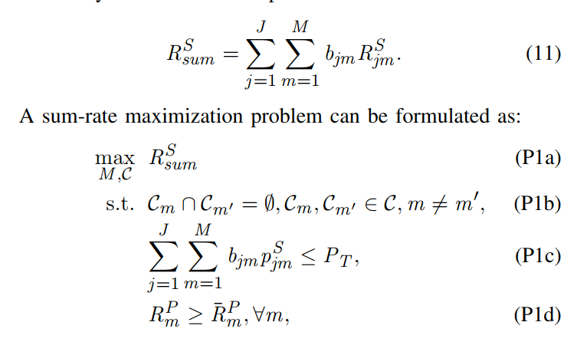
PROBLEM DEFINITION
Optimisation Problem:
Goal: Maximize the sum of data rates for all secondary users.
Constraints:
1. Each user should be assigned to a single cluster. (P1-b)
2. Total power of all secondary users ≤ total BS power. (P1-c)
3. Primary user data rate ≥ minimum QoS requirement. (P1-d)
Keep it or delete it!
Same

Slide 8
PROPOSED USER CLUSTERING APPROACHES
Keep it or delete it!

Slide 9
K-MEANS
Group users based on AOD: Each secondary user (j) has an AOD value (aj) which is assigned to nearest centroid based on distance
Centroids are updated till the condition for stopping is achieved. (standard k-means approach)
Limitations:
Uses a pre-defined number of clusters (k).
Forces outliers into clusters.
Sensitive to initial centroid selection
We are going to use k-means as a benchmark for other proposed algorithms.
Keep it or delete it!
Angle of Departure

Slide 10
DBSCAN
Density-based spatial clustering application with noise
Algorithm:
For all users (1 -> N):
Start with an unvisited user. Check if it has atleast minPts neighbours in Epsilon neighbourhood.
If yes (we call this dense enough), form a new cluster and expand it by adding reachable users.
If no, label it as noise. (although this can be changed later)
Keep it or delete it!
Same
Advantages over k-means:
Determines K dynamically
Labels outliers as noise
Limitations:
Hyperparameters: minPts, Epsilon need to be pre-configured.

Slide 11
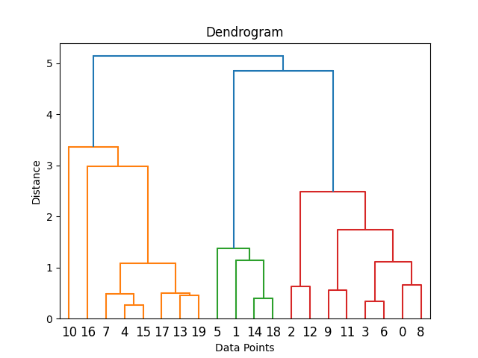
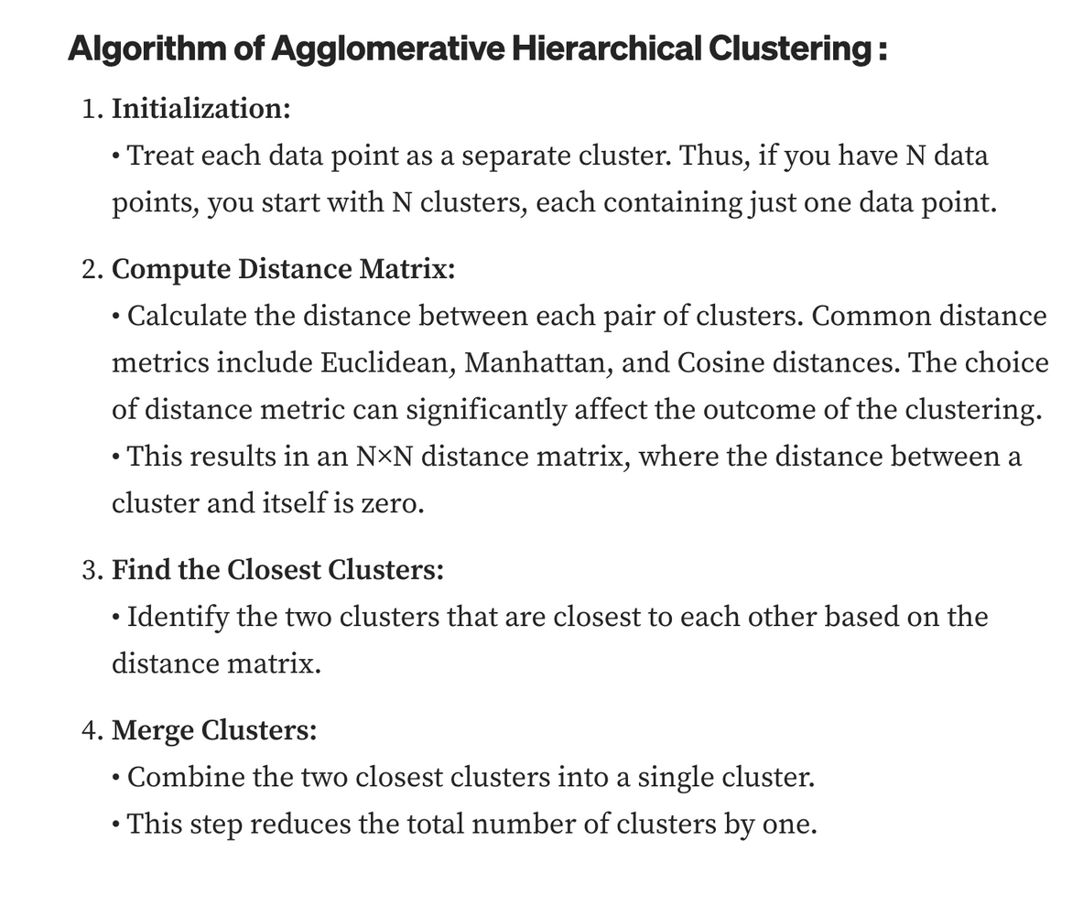
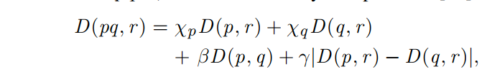
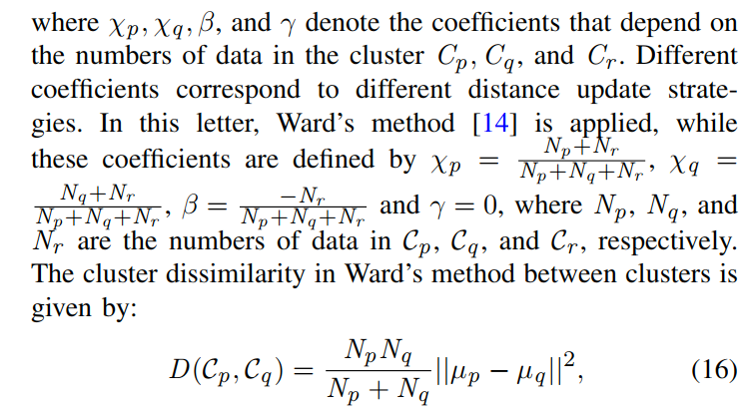
AHC
Same

Slide 12

HOW IS AHC DYNAMIC
No Fixed Cluster Count
Traditional clustering (e.g., K-Means) requires the number of clusters in advance.
AHC automatically determines the number of clusters by progressively merging users based on similarity (e.g., AoD).
Adapts to User Distribution
If users are closely spaced, AHC groups them into fewer clusters.
If users are widely distributed, AHC creates more clusters dynamically.
Threshold-Based Merging
AHC merges users step-by-step until a stopping criterion (e.g., sum rate maximization, minimum beam interference) is met.
The system does not need prior knowledge of cluster count but learns it from the AoD distribution.
Keep it or delete it!
Same

Slide 13
RESULTS OBTAINED
Keep it or delete it!
Same

Slide 14
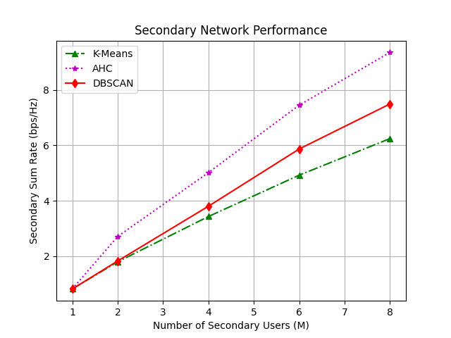
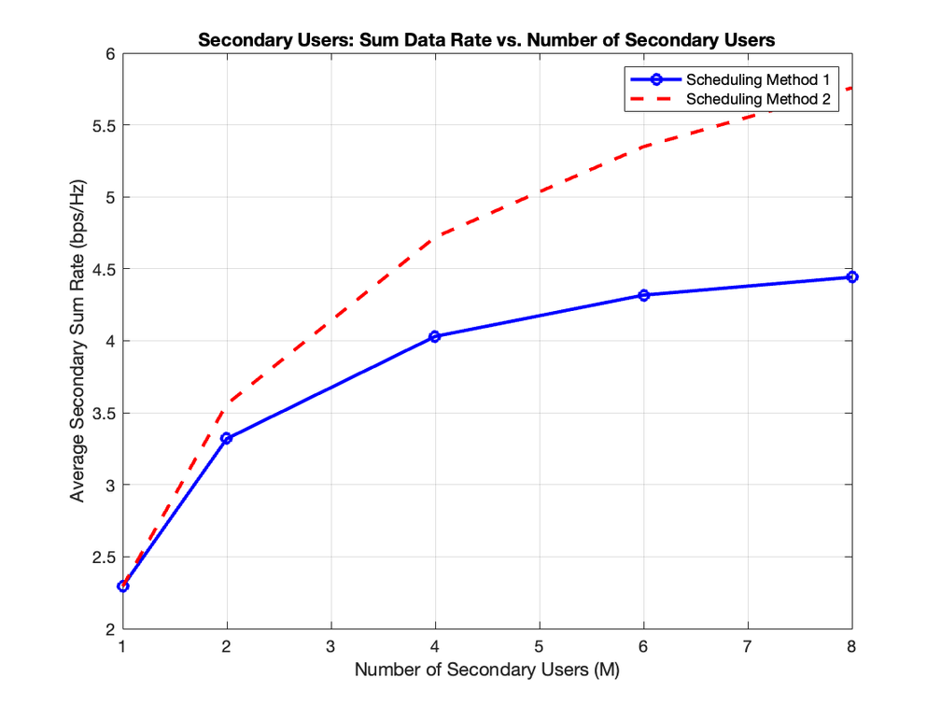
PLOTS
For L = 10(# of antennas at B.S.)
Keep it or delete it!
Same
Link to our code base: https://github.com/Transyltooniaa/Unsupervised-Machine-Learning-Based-User-Clustering-in-THz-NOMA-Systems

Slide 15

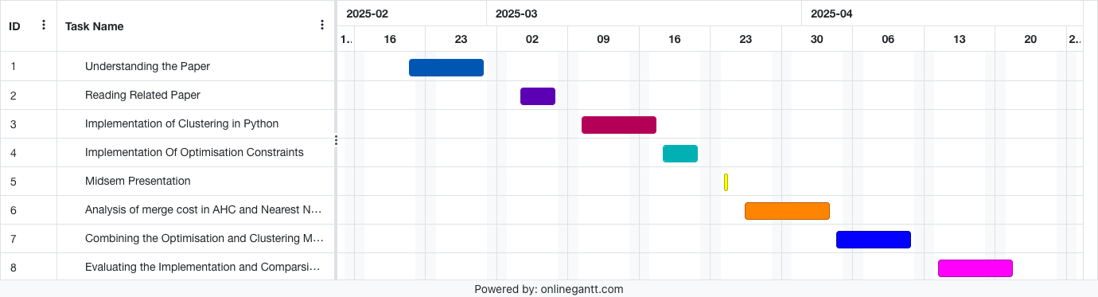
TIMELINE DIAGRAM

Slide 16

THANK YOU

Slide 17

QUESTIONS

